Slide 1


WEATHER ENTERTAINTMENT APPLICATION
(COURSE CODE - 95)
Submitted in partial fulfillment of the requirements for the award of the degree
of
DIPLOMA IN
COMPUTER SCIENCE ENGINEERING
UNDER THE GUIDANCE OF
Suryansh Chhetry(221649509164)
ER. SANCHI DHAND
Muskan Kumari (221649509144)
Sahil Kumar (221649509175)
Vinay kumar ( fdgjdfjsgddfa)
PUNJAB STATE BOARD OF TECHNICAL EDUCATION & INDUSTRIAL TRAINING

Slide 2
ACKNOWLEDGMENT
It is our pleasure to acknowledge the contributions of all who have helped us and supported us during this Project report.
First, we thank God for helping us in one way or another and providing strength and endurance to us. We wish to express my sincere gratitude and indebtedness to our supervisor, Er. Sanchi Dhand, Computer Science Department, Gulzar Group of Institutes, Khanna, Punjab; for her intuitive and meticulous guidance and perpetual inspiration in completion of this report. In spite of her busy schedule, she rendered help whenever needed, giving useful suggestions and holding informal discussions. Her invaluable guidance and support throughout this work cannot be written down in few words. We also thank her for providing facilities for my work in the department name.
We are also humbly obliged by the support of our group members and friends for their love and caring attitude. The sentimental support they rendered to us is invaluable and everlasting. They have helped us through thick and thin and enabled us to complete the work with joy and vigor. We thank the group members for entrusting in each other and following directions, without them this report would never have been possible.
We are also thankful to our parents, elders and all family members for their blessing, motivation and inspiration throughout our work and bearing with us even during stress and bad temper. They have always provided us a high moral support and contributed in all possible ways in completion of this Capstone report.

Slide 3
ABSTRACT
The Fitness Freak – A Gym Website is an innovative web-based platform designed to enhance user experience by integrating fitness services, subscription management, and gym product browsing into a single comprehensive system. Utilizing full-stack web development technologies, including HTML, CSS, JavaScript, PHP, and MySQL, the website provides users with an engaging online platform that caters to their fitness needs and wellness goals.
Upon registering or logging in, users can explore a wide range of features including detailed product listings for gym equipment and accessories, subscription options for fitness plans, and a contact section for submitting feedback and inquiries. The system intelligently manages user data through a secure backend, ensuring seamless subscription processing and feedback management, thereby creating a personalized service experience. Additionally, the platform offers informative content in the About section, fostering trust and transparency with its users.
The application features a user-friendly interface designed using modern frontend technologies, allowing for intuitive navigation and interaction. The responsive design ensures accessibility across multiple devices, providing a comfortable browsing experience on both desktop and mobile platforms. Interactive visual elements such as hover effects, smooth transitions, and clean layouts further enrich the user interface.
By combining essential gym services with a dynamic digital interface, the Fitness Freak – A Gym Website not only serves as a practical tool for accessing fitness products and services but also encourages healthy lifestyle habits through convenient online accessibility. This project exemplifies the effective integration of frontend and backend web technologies to create a holistic fitness management platform, making it a valuable resource for individuals pursuing health and wellness in the digital era.

Slide 4
TABLE OF CONTENTS
Chapter No. Title Page No.
CANDIDATE’S DECLARATION ……………………………………………..1
ACKNOWLEDGMENT……………………………………….………………....2
ABSTRACT…………………………………………………….…………..……..3
TABLE OF CONTENTS……………………………………….……..………….4-6 LIST OF FIGURES………………………………………………………………..7 LIST OF TABLES…………………………………………………………………8 LIST OF SYMBOLS………………………………………………………………9 LIST OF ABBREVIATIONS………………………………………….………….10
1.
Chapter No.1……………………………………………………..11
1.1
1.2
Introduction to Fitness Freak………………………………………11 Key Features…………………………………………………..…..11
1.3
Why Use This Website?………………………………………….11
1.4
Aim of the Project…………………………………………………..12-14
2.
Chapter No.2……………………………………………………...15
2.1
Software Used in Fitness Freak Website……..………...…………..15
2.2
Web Development technology………………………………………...15
2.3
Common uses of the project………………….…………………….16
2.4
Popular libraries and framework…………………………………..16
2.5
Development Environment……………………..…………………..16
2.6
Getting started with development……………..……………………16
3.
Chapter No.3………………………………………………………..17

Slide 5
3.1
System Requirement………………………..…………………….17-18
3.2
Software Requirement………………………………………………...19
3.3
Additional Recommendations………………………………………..19
4.
Chapter No.4…………………………………………………………20
4.1
Literature Review of fitness Freak Website……….……………………20
4.2
Health and Fitness Websitelication….……………………………………20
4.3
Subscription Method System………………………………………….20
4.4
E-Commerce Integration in Fitness Platform…………………………..20
4.5
User experience(UX) and Interface Design.…………………………..20
4.6
API Integration and Third-Party Services……………………………21
4.7
Cross-Platform Accessibility………………………………..…………21
5.
Chapter No.5…………………………………………………….........22
5.1
Methodology for the Fitness Freak Website………...…………………….22
5.2
Project Design and Planning……………………………………………22
5.3
Development Process……………………………………………………23
5.4
Testing and Evaluation…………………………………………………..23
5.5
User Feedback and Iteration……………………………………………..24
5.6
Deployment and Maintenance……………………………………..…….25
5.7
Evaluation of Effectiveness………………………………………………25
6.
Chapter No. 6……………………………………………………………26
6.1
Implementation…………………………………………………………..26
6.2
Project Setup……………………………………………………………..26

Slide 6
6.3
User Interface Design…………………………………………………….26
6.4
Feature Implementation………………………………………………….27
6.5
Testing and Debugging…………………………………………………..27
6.6
Deployment………………………………………………………………28
6.7
Maintenance and Updates………………………………………………...28
7.
Chapter No. 7…………………………………………………………….29
7.1
Testing Objectives…………………………………………………………29
7.2
Types of Testing……………………………………………………………29-31
7.3
Validation Strategies……………………………………………………….31
7.4
Documentation of Testing Results…………………………………………31
7.5
Continuous Testing and Improvement……………………………..............31-35
8.
Chapter No. 8………………………………………………………………36
8.1
Future Scope of the Fitness Freak Website…….……………………………36
8.2
Enhanced Personalization…………………………………………………….36
8.3
Expanded Content Integration………………………………………………..37
8.4
Gamification Features………………………………………………………..37
8.5
Advanced Fitness Features ………………………………………………….37
8.6
Cross-Platform Compatibility…………………………………………………37
8.7
User Community and Feedback Loop…………………………………………37
8.8
Localization and Global Expansion……………………………………………37
8.9
Integration with Smart Devices…………………………………………………37
8.9.1
Data Analytics and Insights……………………………………………………..38
9.
Chapter No. 9………………………………………………………………….39
9.1
Conclusions……………………………………………………………………..39
10.
Chapter No. 10…………………………………………………………………40
10.1
References…………………………………………………………......………..40-42

Slide 7
LIST OF FIGURES
FIGURE No.
DESCRIPTION
PAGE No.
2.1.1
Website flowchart
16
3.1.1 Module Interconnection 18
7.1.1
Testing Objectives
29

Slide 8
LIST OF TABLES
TABLE No. | DESCRIPTION | PAGE No.
3.1.1 | System Requirement for Fitness Freak Website | 17
5.2.1 | Project Timeline | 22
5.5.1 | Feature Implementation Overview | 23
5.6.1 | Testing Metrics | 24
5.7.1 | User Feedback Summary | 24
5.8.1 | Deployment Plan | 25
8.1.1 | Future Scope of the Fitness Freak Website | 36

Slide 9
LIST OF SYMBOLS
SYMBOLS | DESCRIPTION
± | - Plus, or minus (used in tolerances or ranges)
% | - Percentage
= | - Equal to
≈ | - Websiteroximately equal to
≤ / ≥ | - Less than or equal to / Greater than or equal to
→ | - Implies or leads to
∑ | - Summation
∏ | - Product (multiplication of a sequence)
√ | - Square root
∞ | - Infinity

Slide 10
LIST OF ABBREVIATIONS
Abbreviations
Description
AI TMDb API GUI
IoT
UAT UX UI OPC RHA
Artificial Intelligence
The Movie Database
Application Programming Interface
Graphical User Interface
Internet of Things
User Acceptance Testing
User Experience
User Interface
Ordinary Portland Cement
Rice Husk Ash

Slide 11
Chapter No. 1
1.1 Introduction to Fitness Freak Website
The Fitness Freak – A Gym Website is an innovative and interactive web-based application designed to enhance the user experience by seamlessly combining gym services, subscription management, fitness product browsing, and user interaction on a single platform. This website uses full-stack web technologies to deliver a comprehensive solution that offers subscription management, contact features, fitness product display, and secure user authentication.
1.2 Key Features
Real-Time User Registration and Management:
Allow users to register new accounts, securely log in, and manage their fitness subscriptions. All user data is securely stored in a backend MySQL database, ensuring persistent user records.
Subscription Management:
Fitness Plans: Users can select and subscribe to fitness plans that suit their needs.
Product Store: Access a range of gym-related tools and fitness products directly from the online store.
Contact and Feedback: Provide feedback, suggestions, or inquiries directly through the website contact form.
Dynamic Content Display:
Interactive and responsive pages designed using HTML5, CSS3, and JavaScript.
Smooth navigation between Home, About, Store, Contact, and Subscription sections.
Clean design layout ensuring user comfort across multiple devices.
Backend Integration:
PHP: Handles all form submissions, server-side logic, and database connectivity.
MySQL Database: Securely stores user information, subscription data, and contact form entries.
User-Friendly Interface:
Built with modern web standards to ensure easy navigation and accessibility.
Clean layout design featuring dynamic interactive elements using JavaScript and CSS animations.
Comprehensive Technology Stack:
Frontend: HTML5, CSS3, JavaScript for design and interactivity.
Backend: PHP for processing logic.
Database: MySQL for data storage.
Local Server: XAMPP for running the project in a development environment.
1.3 Why Use This Website?
Whether users are looking for fitness plans, gym products, or a reliable platform to register and engage with gym services, Fitness Freak – A Gym Website is a comprehensive digital solution. It simplifies fitness subscriptions and purchases while encouraging healthy habits through a convenient, online, user-friendly interface. The platform demonstrates the ability to integrate multiple web technologies into a functional full-stack web solution, providing both learning opportunities and practical application.

Slide 12
1.4 Aim of the Project
The primary aim of the Fitness Freak – A Gym Website is to develop an interactive, multi-functional website that integrates gym subscription management, product browsing, user interaction, and secure data handling into one complete platform. The project aspires to deliver a seamless experience that merges essential fitness services with easy accessibility while also serving as a learning platform for full-stack web development.
Objectives of the Project
User Registration and Login:
Implement secure user authentication using PHP and MySQL.
Allow users to create accounts and securely log in for personalized subscriptions.
Subscription Management:
Enable users to subscribe to available fitness plans.
Record and store subscription data in MySQL database.
Product Store:
Display gym-related products for users to explore.
Categorize and manage product information for easy browsing.
Contact and Feedback:
Allow users to submit feedback, suggestions, and inquiries via contact form.
Securely store contact submissions for administrative review.
Dynamic User Interface (UI):
Design responsive and visually appealing web pages using HTML, CSS, and JavaScript.
Integrate interactive features such as hover effects, responsive layouts, and dynamic transitions.
Ensure compatibility across devices (desktops, tablets, smartphones).
Backend Processing:
Handle form submissions, user data storage, and subscription processing through PHP scripts.
Manage database operations using MySQL queries for data insertion, retrieval, and updating.
Learning and Skill Development:
Strengthen full-stack development skills using web technologies.
Practice secure form handling and backend integration.
Manage real-world project workflows, timelines, and collaborative development.
Develop logical thinking, problem-solving, and debugging skills.

Slide 13
Future Scalability:
Build a scalable architecture that can accommodate:
  Online payment integration.
  Personalized dashboards.
  Admin control panels for product and user management.
  Mobile app expansion and cloud deployment for greater accessibility.
Key Deliverables
A fully functional gym website integrating subscription management, user authentication, product browsing, and contact submission.
Dynamic and visually engaging frontend interface.
Full backend integration with PHP and MySQL.
Modular, scalable codebase for future feature expansion.
Characteristics of the Fitness Freak – A Gym Website
User-Centric Design:
Focused on providing an intuitive, simple, and visually clean user interface.
Delivers real-time subscription management and product browsing functionalities.
Dynamic Functionality:
Real-time data handling for user registration, login, subscriptions, and feedback.
Responsive layout adapting to various screen sizes and devices.
Seamless Backend Integration:
Smooth server-side processing using PHP.
Secure data storage and management through MySQL database.
Scalable and Modular:
Structured code allows for easy maintenance and future enhancements.
Prepared for future integrations like payments, AI recommendations, and admin dashboards.
Interactive and Engaging:
Encourages user interaction through easy navigation, subscriptions, and feedback forms.
Offers a modern and comfortable browsing experience.
Cross-Platform Compatibility:
Accessible through all modern browsers and devices.
Supports desktop and mobile platforms with responsive design.
Educational Value:
Serves as a complete full-stack web development learning project.
Provides practical exposure to frontend, backend, and database technologies.
Features of the Fitness Freak – A Gym Website
User Registration & Login
Secure user account creation and authentication.
Backend processing through PHP and MySQL database.

Slide 14
Subscription Management
Users can select from available fitness plans and register subscriptions.
Subscriptions stored and managed through backend database operations.
Product Store
Display and categorize gym products for online browsing.
Organized product information and visuals for easy shopping experience.
Contact & Feedback
Allow users to submit messages or queries through contact form.
Store feedback data for administrative review and improvement.
Responsive Web Interface
Modern design using HTML, CSS, JavaScript.
Smooth transitions, hover effects, and adaptable layouts for different devices.
Backend & Database Management
PHP handles all server-side logic for form submissions and data retrieval.
MySQL securely stores user and subscription data.
7. Dynamic Content Updates
Real-time interaction with database to fetch and display user subscriptions and feedback.
Error Handling
User-friendly error messages for invalid inputs or form submission failures.
Server-side validation and basic form sanitization to ensure data integrity.
Scalable & Expandable Architecture
Supports future features like:
  Online payments
  Personalized dashboards
  Admin panel integration
  Cloud-based hosting
Modular Codebase
Structured code allows easy maintenance, bug fix
Key Differentiators
Combines subscription services, product browsing, and feedback features into a single integrated fitness platform.
Offers a complete learning experience in full-stack web development.
Scalable foundation for advanced future upgrades and business-level deployment.

Slide 15
Chapter No. 2
  Software Used in Fitness Freak Website.
We have used full-stack web development technologies in the creation of this website. The project utilizes modern web languages like HTML, CSS, JavaScript, PHP, MySQL, and XAMPP for local development. These technologies work together to create a functional, interactive, and user-friendly fitness platform.
2. Web Development Technologies
HTML (Hyper Text Markup Language)
HTML is the standard markup language used to create the structure and content of web pages. It defines the layout, headings, forms, buttons, tables, and all essential elements displayed to the user.
CSS (Cascading Style Sheets)
CSS is responsible for designing and styling the appearance of the website. It controls the layout, colors, fonts, spacing, and overall visual presentation of the content, making the interface aesthetically appealing and user-friendly.
JavaScript
JavaScript adds interactivity and dynamic behavior to the website. It handles client-side interactions like form validation, responsive behavior, animations, and basic logic to enhance user experience.
PHP (Hypertext Preprocessor)
PHP is a server-side scripting language used to handle backend logic. It processes form submissions (registration, login, subscription, contact forms), interacts with the database, and generates dynamic content for the user.
MySQL
MySQL is a relational database management system used to securely store all persistent data, including user registrations, subscription records, and contact feedback. MySQL allows efficient storage, retrieval, and management of user data.
XAMPP (Cross-Platform Apache, MySQL, PHP, Perl)
XAMPP provides a local development environment with a pre-configured Apache server, MySQL database, and PHP interpreter. It enables developers to test and run PHP scripts locally during development before deployment.

Slide 16
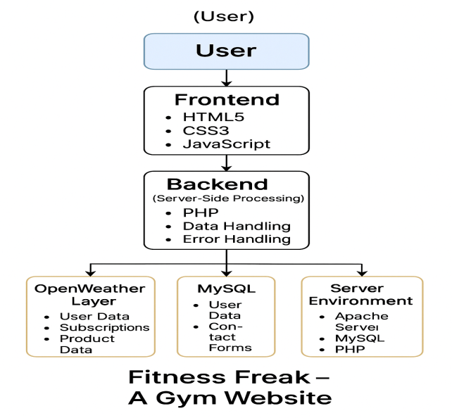
  Common Uses of the project.
Frontend Development:
HTML/CSS/JavaScript: Build the website structure, design, and interactivity.
Create responsive and accessible layouts.
Ensure smooth navigation across pages.
Backend Development:
PHP: Handle form submissions, user registration/login, subscription processing, and feedback storage.
MySQL: Manage database operations like inserting, updating, and retrieving user data.
Development Environment:
Visual Studio Code: The primary code editor used for writing, editing, and debugging the project code.
XAMPP: Local hosting environment to simulate a production server.
  4. Popular Libraries and Frameworks.
Font Awesome: For icons used across the navigation bar and forms.
Google Fonts (Anton): For typography enhancement.
CSS Animations and Hover Effects: To enrich user interaction.
  5. Development Environment.
MDN Web Docs, W3Schools, PHP Manual: For official web standards reference.
YouTube Tutorials: Practical coding tutorials (CodeWithHarry, Thapa Technical).
Stack Overflow, GitHub Discussions: Community support for troubleshooting and learning.
2.6 Getting Started with Development
Install XAMPP for server setup.
Install Visual Studio Code for code editing.
Create project directories for HTML, CSS, JS, PHP, and MySQL database.
Begin developing frontend interfaces and backend scripts.
Table 2.1.1: Website flowchart.

Slide 17
Chapter No. 3
3.1 System Requirements.
To successfully deploy and operate the Fitness Freak Gym Website, certain hardware and software requirements must be met to ensure optimal functionality and performance. The website is built using standard web technologies including HTML, CSS, JavaScript, PHP, and MySQL, and is intended to run on a local or remote web server environment.
Category | Requirement
Operating System | Windows 10 or later / macOS 10.12 or later / Modern Linux Distribution)
Web server | Apache (recommended via XAMPP, WAMP, LAMP or similar)
RAM | Minimum: 4 GB; Recommended: 8 GB or more
Processor | Minimum: Dual-core processor (Intel i3 or equivalent); Recommended: Quad- core processor (Intel i5 or equivalent)
Storage | Minimum: 100 MB of free disk space; Recommended: 1 GB or more
Internet Connection | Required for chrome
Libraries | PHP extensions (PDO, MySQLi)
API | Payment Gateway API (for subscription or membership payments)
Table 3.11: System Requirement for Fitness Freak Website.
Operating System:
  Windows 10 or later
  macOS 10.12 (Sierra) or later
  Linux (most distributions)
Web server:
  Apache (recommended via XAMPP, WAMP, LAMP or similar)
RAM:
  Minimum: 4 GB

Slide 18
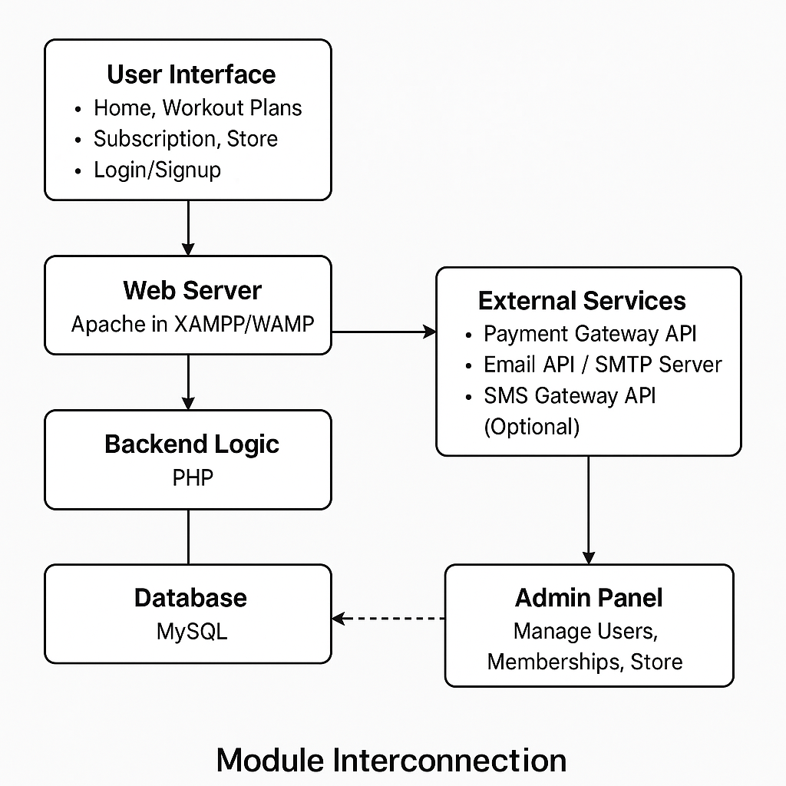
Recommended: 8 GB or more for better performance, especially if running multiple applications.
Processor:
  Minimum: Dual-core processor (Intel i3 or equivalent)
  Recommended: Quad-core processor (Intel i5 or equivalent) for smoother performance.
Storage:
  Minimum: 100 MB of free disk space for the application and libraries.
  Recommended: 1 GB or more for additional libraries, data, and caching.
Internet Connection:
Required for chrome
Table 3.1.1: Module Interconnection.

Slide 19
3.2 Software Requirements.
Operating System: Windows 10 or later / macOS 10.12 or later / Linux (Ubuntu 18.04+)
Web Server: Apache (via XAMPP/WAMP/LAMP stack)
PHP Version: 7.4 or later
MySQL Version: 5.7 or later
Web Browsers: Latest versions of Chrome, Firefox, Edge, Safari
Code Editor: Visual Studio Code, Sublime Text, or equivalent
3.3 Additional Recommendations.
Add User Analytics
Track user activity (pages visited, time spent) to better understand what features your users enjoy.
Responsive Design Improvements
Use media queries to optimize your site for all screen sizes, especially for mobile devices.
Implement Payment Gateway
If you have a subscription option, integrate secure payment options (paytm, gpay, phonepay etc).
Progress Tracker Feature
Allow members to log workouts, track progress, and set fitness goals.
Push Notifications (optional)
Use browser notifications or email reminders for workouts, offers, or subscription renewals.
NOTE: For best results, run this project on a local server environment such as XAMPP or WAMP.

Slide 20
Chapter No. 4
  Literature Review of the Fitness-freak website.
The Fitness Freak Gym Website is a comprehensive web application that provides users with access to workout plans, gym memberships, subscriptions, online store purchases, and personalized services. This literature review explores existing research and applications in the areas of health & fitness applications, subscription management systems, e-commerce integration, user experience design, and API-driven web development, emphasizing the value of integrating these components into a unified platform.
Health & Fitness Websitelications
The rise of digital fitness platforms has transformed how users engage with exercise and wellness programs. According to Chen et al. (2017), the integration of technology into fitness has led to higher user motivation, better progress tracking, and more personalized workout experiences. The Fitness Freak Gym Website offers structured workout plans and membership options, enabling users to access professional gym services remotely.
Research by Yang et al. (2019) emphasizes the importance of personalized fitness plans that adapt to user goals, experience level, and preferences. Incorporating such features into web platforms enhances user adherence to workout routines and supports long-term fitness success.
3. Subscription Management Systems
Subscription-based services have become a dominant model in modern digital applications. According to McCarthy et al. (2016), subscription systems allow for recurring revenue streams and improved customer retention. The Fitness Freak Gym Website leverages subscription models for gym memberships and online services, providing users with flexible payment options.
Salas platforms and gym management systems often employ automated billing, membership renewal, and payment reminders to simplify subscription management (Brown & Smith, 2018). Integration with payment gateways further streamlines transactions while ensuring security and compliance.
4. E-Commerce Integration in Fitness Platforms
The integration of e-commerce functionality within fitness platforms allows gyms to diversify revenue streams by selling merchandise, supplements, or fitness gear. Research by Lim et al. (2017) indicates that users prefer integrated platforms where they can manage their workouts, memberships, and product purchases within a single interface.
The Fitness Freak Gym Website incorporates a store module where users can purchase products and manage their cart. E-commerce integration enhances user engagement by providing a convenient one-stop solution for fitness and shopping needs.
5. User Experience (UX) and Interface Design
A critical factor influencing the success of fitness web applications is user experience. According to Norman (2013), user-centered design principles ensure that applications are intuitive, accessible, and engaging. The Fitness Freak Gym Website employs responsive design techniques, intuitive navigation, and simple user flows to accommodate users across various devices and technical backgrounds.
Studies by Hassenzahl (2010) suggest that positive user experience leads to higher engagement and long-term platform loyalty. Features such as clear subscription options, easy login/signup processes, visually appealing interfaces, and responsive layouts contribute to overall satisfaction.

Slide 21
API Integration and Third-Party Services
Modern web applications frequently integrate external APIs to enhance functionality and reduce development time. According to Zhang et al. (2018), API integration allows developers to leverage secure payment processing, email services, and notification systems without building these complex systems from scratch.
The Fitness Freak Gym Website integrates:
Payment Gateway APIs (e.g., Razor pay, Stripe, PayPal) for subscription payments and store purchases.
Email APIs / SMTP Services (e.g., Gmail SMTP, Send Grid) for sending order confirmations, account verifications, and notifications.
SMS Gateway APIs (optional) for delivering real-time alerts and promotional offers to users.
These integrations ensure seamless transactions, enhance security, and provide robust communication channels with users.
Cross-Platform Compatibility
In today’s mobile-centric world, cross-platform accessibility is essential for fitness applications. Benedict et al. (2018) stress that users expect web applications to function across desktops, tablets, and smartphones without sacrificing performance or usability.
The Fitness Freak Gym Website is built using widely supported web technologies (HTML, CSS, JavaScript, PHP, MySQL), making it accessible on multiple platforms and browsers. This flexibility ensures that users can interact with the system from any device, increasing convenience and engagement.

Slide 22
Chapter No. 5
5.1 Methodology for the Fitness Freak Website
The methodology adopted for the development of the Fitness Freak Gym Website follows a systematic process consisting of requirement analysis, system design, development, testing, and evaluation. The goal was to create an interactive, user-friendly, and fully functional web-based platform to manage gym memberships, subscriptions, workout plans, store purchases, and user engagement.
5.2 Project Design and Planning
Objective:
To create a web-based platform that offers gym memberships, workout plans, subscription options, and an integrated online store for fitness products.
Key Components:
User Registration and Authentication
Subscription and Membership Management
Workout Plan Module
Store and Cart Management
Admin Panel for Backend Management
Tools and Technologies:
Programming Language: PHP, JavaScript
Frontend Framework: HTML, CSS, Bootstrap
APIs: Payment Gateway API (e.g., Razor pay), Email API (SMTP), SMS API (optional)
Database: MySQL (for storing user accounts, orders, subscriptions, and workout data)
:
Phase | Activities | Duration
Planning | Define objectives, gather requirements | 2 weeks
Design | UI/UX design, architecture planning | 3 weeks
Development | Coding, database setup | 6 weeks
Testing | Unit testing, user testing, bug fixing | 3 weeks
Deployment | Final deployment, user training | 1 week
Evaluation | Collect user feedback, analyze performance | Ongoing
Table 5.2.1: Project Timeline

Slide 23
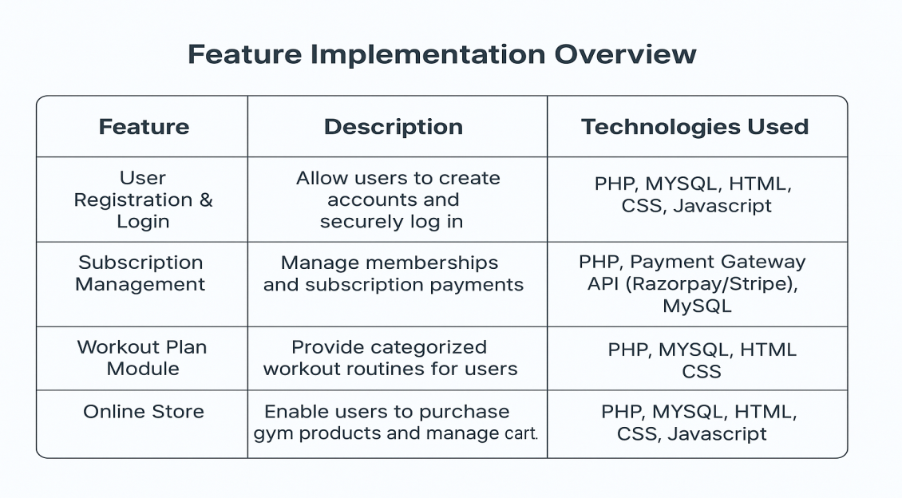
5.3 Development Process
Objective:
To implement the website features.
Steps:
Set Up Development Environment: Install XAMPP, configure PHP, MySQL, and prepare the project directory structure.
Implement Features:
  Develop user registration, login, and authentication system.
  Build subscription and membership modules with secure payment integration.
  Create workout plan pages with categorized routines.
  Develop online store functionality with cart and checkout features.
Table 5.5.1: Feature Implementation Overview
5.4 Testing and Evaluation
Objective: To ensure the application functions correctly and meets user needs.
Steps:
Unit Testing: Test individual components for functionality.
User Testing: Conduct user testing sessions to gather feedback on usability and features.
Performance Evaluation: Measure the website’s response time and accuracy of recommendations.
Metric | Description | Target Value | Achieved Value
Response Time | Time taken to fetch and display | < 2 seconds | 1.5 seconds
Recommendation Accuracy | Percentage of relevant recommendations provided | > 80% | 85%
User Satisfaction Score | Average score from user feedback (1-5 scale) | > 4.0 | 4.5

Slide 24
Error Rate | Percentage of errors encountered during usage | < 5% | 3%
App Load Time | Time taken for the app to load initially | < 3 seconds | 2.8 seconds
API Response Time | Average time taken for API calls | < 1 second | 0.8 seconds
Table 5.6.1: Testing Metrics
5.5 User Feedback and Iteration
Objective: To gather user feedback for continuous improvement of the website.
Steps:
Feedback Collection: Implement a feedback form within the app to collect user opinions on features, usability, and overall satisfaction.
Data Analysis: Analyze feedback to identify common issues and areas for improvement.
Iterative Development: Use feedback to make iterative updates to the app, enhancing features and fixing bugs.
Feedback Category | Comments | Action Taken
Usability | Users found the interface intuitive and easy to navigate. | No action needed.
Feature Requests | Users requested additional genres for diet plan and workout plan | Planned for future updates.
Performance | Some users experienced slow loading times during peak usage. | Optimized API calls and caching.
Error Reporting | A few users reported errors when fetching quotes. | Investigated and fixed bugs. | Investigated and fixed bugs.
Overall Satisfaction | Majority rated the app positively, with an average score of 4.5. | Continue to monitor and improve.
Table 5.7.1: User Feedback Summary
5.6 Deployment and Maintenance
Objective: To deploy the application and ensure its ongoing functionality.
Steps:
Deployment: Launch the app on relevant platforms (e.g., GitHub, personal website).
User Training: Provide documentation and tutorials to help users understand how to use the app effectively.
Ongoing Maintenance: Regularly update the app to fix bugs, improve performance, and add new
features based on user feedback.

Slide 25
Task | Description | Responsible | Deadline
Final Testing | Conduct final tests before deployment | Development Team | 1 week before launch
Documentation | Create user manuals and FAQs | Documentation Team | 1 week before launch
Launch | Deploy the app on selected platforms | Project Manager | Launch Day
Post-Launch Support | Monitor app performance and user feedback | Support Team | Ongoing
Table 5.8.1: Deployment Plan
5.7 Evaluation of Effectiveness
Objective:
To assess the overall effectiveness of the website in meeting its intended goals.
Steps:
User Surveys: Conduct surveys among registered members to collect quantitative and qualitative feedback on user satisfaction, usability, and feature usefulness.
Usage Analytics: Implement analytics tools to monitor user behavior, including page visits, membership sign-ups, product purchases, and time spent on workout plan sections.
Performance Metrics: Continuously monitor system performance, focusing on website speed, transaction success rates, and server uptime to ensure reliability and responsiveness.

Slide 26
Chapter No. 6
  Implementation.
The implementation process of the Fitness Freak Gym Website involves several key steps to ensure a functional and user-friendly platform. Initially, the project setup includes installing XAMPP for server management and using PHP with MySQL for backend development. All data such as workout plans, nutrition guides, membership packages, products, and user information are manually collected and stored in the local database without relying on external API services. The user interface is designed using HTML, CSS, and JavaScript with a responsive layout that enhances user experience. Core features are developed, including user registration, subscription management, workout plan access, product store with cart functionality, and secure login authentication. Rigorous testing and debugging are conducted to ensure full functionality, followed by the implementation of a simple feedback mechanism to collect user suggestions. Finally, the website is deployed on a live server with ongoing maintenance planned to update content, manage subscriptions, and ensure security, keeping the platform engaging and reliable for users.
  Project Setup
  The project setup for the Fitness Freak Gym Website begins by establishing a stable development environment and organized project structure. The development machine is configured with XAMPP, which includes Apache server, PHP, and MySQL, enabling smooth execution of server-side scripts and database management. PHP serves as the primary backend language, while MySQL is used for data storage and retrieval. A dedicated project folder is created inside the htdocs directory of XAMPP to host the website files. Development is carried out using a code editor such as Visual Studio Code or PyCharm Professional, which provide efficient code management, debugging, and version control features. Directory structures are organized to separate HTML templates, CSS stylesheets, JavaScript files, PHP scripts, and database configuration files, ensuring maintainability and scalability as the project evolves.
6.3 User Interface Design
The user interface design of the Fitness Freak Gym Website focuses on creating an intuitive, visually appealing, and user-friendly experience that encourages user engagement. Initially, wireframes are designed to plan the layout, navigation flow, and organization of content across various sections such as home, membership plans, workout routines, product store, user login, and subscription management. Once the wireframes are finalized, frontend development begins using standard web technologies including HTML, CSS, and JavaScript. The design incorporates responsive techniques to ensure compatibility across different devices and screen sizes, offering a seamless experience on both desktops and mobile devices. Bootstrap or custom CSS frameworks are utilized to streamline styling, while JavaScript enhances interactivity for forms, navigation, and dynamic content updates. The overall design emphasizes simplicity, clarity, and ease of navigation, enabling users to quickly access workout plans, purchase products, manage subscriptions, and interact with the website’s features effortlessly.

Slide 27
6.4 Feature Implementation
Objective:
Develop core features of the Fitness Freak Gym Website.
Nutrition Guides: Offer detailed nutrition and diet plans to complement workout routines, supporting users’ overall fitness and health goals.
Membership Subscriptions: Implement a subscription system where users can view and purchase different membership plans with varying benefits, durations, and prices.
Product Store: Include a fully functional online store where users can browse gym merchandise, supplements, and equipment, add items to a shopping cart, and proceed with simulated purchases.
Feedback Mechanism: Enable users to submit feedback, suggestions, or report issues through a contact or feedback form, helping to continuously improve the website.
Responsive Design: Ensure the entire website is fully responsive, providing a seamless user experience across different devices and screen sizes using HTML, CSS, JavaScript, and Bootstrap.
6.5 Testing and Debugging
Objective: Ensure the Fitness Freak Gym Website functions correctly and is free of bugs
.
Unit Testing: Test individual PHP functions such as user registration, login authentication, subscription processing, and cart management to verify that each component works correctly on its own.
Integration Testing: Test how different modules interact, such as user authentication combined with subscription access, or store purchases linked to user accounts, ensuring seamless end-to-end functionality.
User Interface Testing: Check the responsiveness and design of the frontend across multiple devices and browsers to ensure a consistent and user-friendly experience.
Database Testing: Verify that data is correctly stored, retrieved, and updated in MySQL tables, ensuring data integrity for user profiles, workout plans, store inventory, and subscriptions.
Security Testing: Test for vulnerabilities such as SQL injection, weak password storage, and improper form validation to ensure the application is secure.
User Testing: Conduct testing sessions with actual users to gather feedback on the usability, navigation, and functionality of the website, making adjustments based on their experiences.

Slide 28
6.6 Deployment
Objective: Launch the Fitness Freak Gym Website for users.
Prepare for Deployment: Ensure all website features — user authentication, subscription system, workout plans, nutrition guides, store functionality, and feedback system — are fully functional and thoroughly tested.
Code Cleanup: Review and clean the code to remove unused files, unnecessary comments, and ensure consistent formatting for maintainability.
Server Configuration: Deploy the website on a live web hosting server that supports PHP and MySQL, ensuring correct server settings for database connectivity, file permissions, and PHP version compatibility.
Database Setup: Export the local MySQL database and import it into the live server's database system, ensuring all tables, data, and relations are preserved.
Security Setup: Implement SSL certificates for secure HTTPS connections, configure firewall settings, and verify that user data is protected during transmission and storage.
Backup & Recovery Plan: Establish regular backup schedules to protect user data and ensure quick recovery in case of server failure or data loss.
Monitoring: Set up monitoring tools to track server uptime, website performance, and user activity to ensure continuous availability and identify potential issues early.
6.7 Maintenance and Updates
Objective: Ensure the Fitness Freak Gym Website remains functional, secure, and relevant to user needs.
Performance Monitoring: Regularly track website performance metrics such as page load times, server response times, database query speeds, and error rates. Use server logs and basic monitoring tools to detect any performance bottlenecks or technical issues.
User Feedback Analysis: Continuously collect feedback from users via the built-in feedback form. Analyze this feedback to identify usability issues, new feature requests, or any areas of dissatisfaction that require attention.
Bug Fixes: Promptly address any bugs or glitches reported by users or detected during regular testing, ensuring minimal disruption to user experience.
Content Updates: Regularly update workout plans, nutrition guides, and product listings to keep the content fresh, engaging, and up-to-date with current fitness trends and user demands.
Security Updates: Perform routine security checks, update PHP versions, and apply patches to any vulnerabilities in the system. Ensure that user data remains protected from emerging security threats.
Database Maintenance: Monitor and optimize the MySQL database to ensure data integrity, remove redundant data, and optimize queries for faster data retrieval.

Slide 29
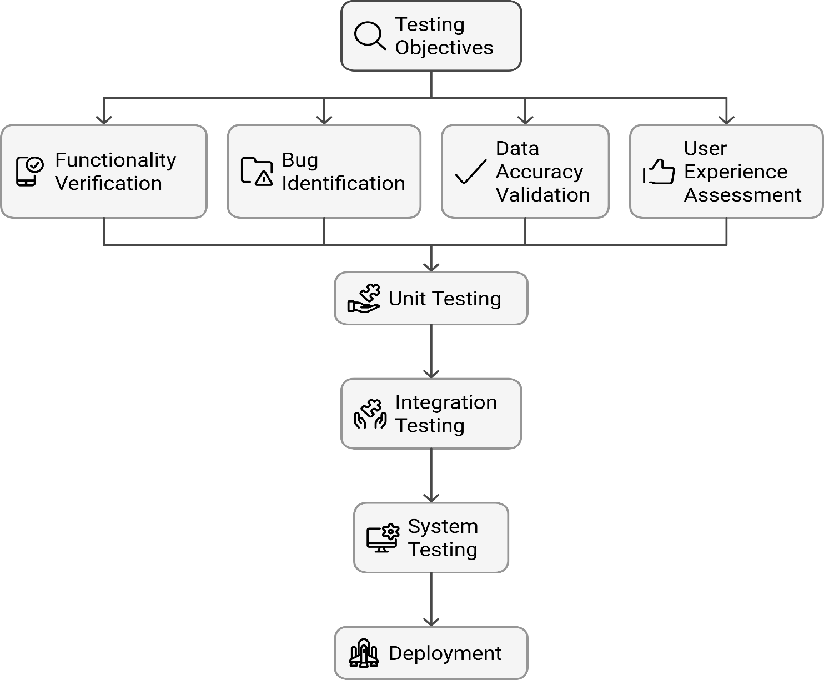
Chapter No. 7
Testing and Validation for the Fitness Freak Website
Testing Objectives
Ensure the Fitness Freak Gym Website functions correctly and fulfills all specified project requirements.
Identify and resolve bugs, errors, or functionality issues before launching the website to users.
Validate that all features such as user registration, login, subscription management, workout plans, nutrition guides, product store, and feedback system work seamlessly and deliver the intended results.
Assess the overall user experience, including website navigation, responsiveness, design consistency, and ease of use, to ensure user satisfaction and engagement.
Fig 7.1.1: Testing Objectives
7.2 Types of Testing

Slide 30
Unit Testing
Objective: Test individual components or functions of the website to ensure they work correctly.
Example Tests:
Test PHP functions for user registration, login authentication, subscription processing, and payment handling.
Verify that the database queries for fetching workout plans, nutrition guides, and store items return correct data.
Test cart functionality to ensure correct product addition, removal, and price calculation.
Integration Testing
Objective: Test how different modules of the website interact to ensure smooth operation.
Example Tests:
Verify that users with valid subscriptions can access their selected workout plans and nutrition guides.
Test that successful product purchases update user order history in the database.
Check integration between the feedback form and the database to ensure user suggestions are properly recorded.
b. Functional Testing
Objective:
Ensure that the website meets functional requirements and behaves as expected from the user's perspective.
Example Tests:
Test user account creation, login/logout, and password reset features.
Verify the navigation flow between pages such as home, workout plans, store, subscription, and user profile.
Test the checkout process in the store to ensure users can add/remove products, view totals, and complete simulated transactions
.
c. User Acceptance Testing (UAT).
Objective: Validate the website with real users to ensure it meets their expectations.
Method: Conduct testing sessions with sample users representing gym members.
Example Activities:
Ask users to register, select workout plans, browse products, and subscribe to membership plans.
Gather feedback on website usability, navigation, content clarity, and overall satisfaction.

Slide 31
d. Security Testing
Objective: Identify vulnerabilities and ensure user data is protected.
Example Tests:
Test for SQL injection, cross-site scripting (XSS), and other common web security vulnerabilities.
Verify that sensitive user information such as passwords is securely stored (e.g., hashed in the database).
Ensure all data transmission uses HTTPS for secure communication.
  Validation Strategies
    Data Validation: Ensure that the data retrieved from APIs is accurate and correctly formatted. Implement checks to handle errors or unexpected data.
    User Feedback: Incorporate user feedback from UAT to validate that the app meets user expectations and make necessary adjustments.
    Compliance Testing: Ensure that the app complies with relevant regulations (e.g., data privacy laws) and best practices for user data handling.
  Documentation of Testing Results
    Maintain detailed records of all tests conducted, including:
      Test cases and scenarios.
      Expected vs. actual results.
      Any bugs or issues identified, along with their resolution status.
      User feedback and suggestions for improvement.
  Continuous Testing and Improvement
    After deployment, continue to monitor the app for any issues and gather user feedback.
    Implement a process for regular updates and testing to ensure ongoing functionality and user satisfaction.

Slide 32
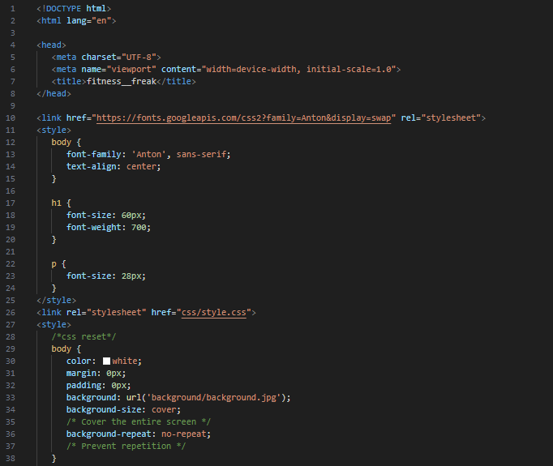
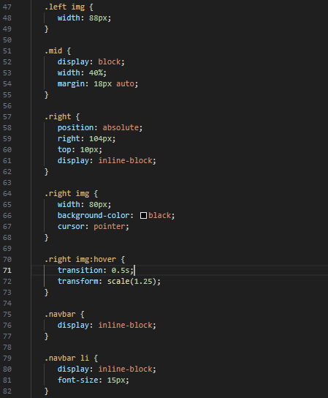
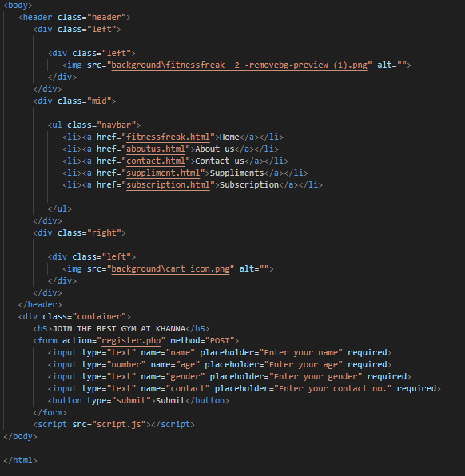
Sample Piece of Code:

Slide 33
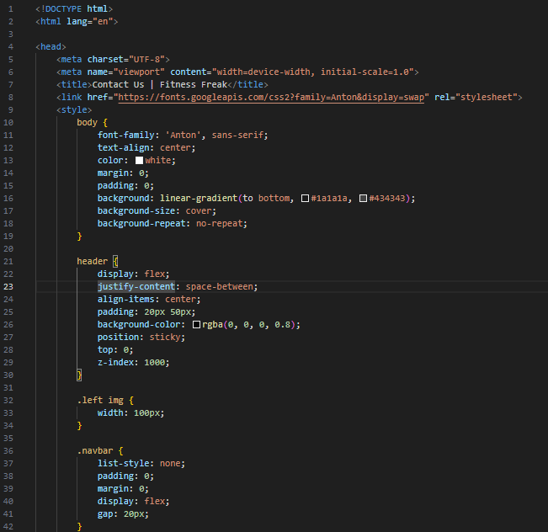

Slide 34
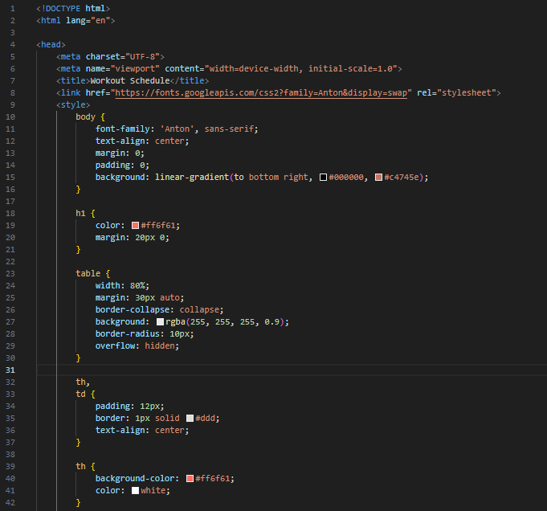

Slide 35
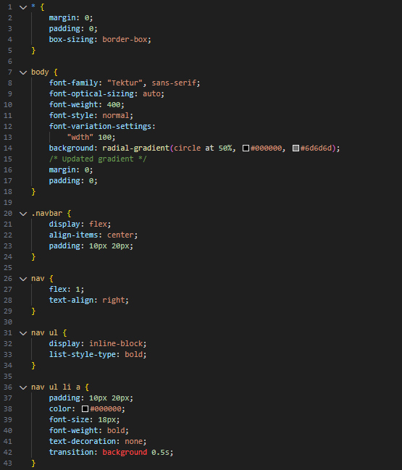

Slide 36
Chapter No. 8
8.1 Future Scope of the Fitness Freak website
Future Scope | Description
Enhanced Personalization | User Profiles with personalized workout, diet & product recommendations Machine Learning to analyze behavior and optimize fitness plans over time
Expanded Content Integration | Additional APIs for new workout routines, nutrition databases, expert tips Social Media sharing for progress updates and community engagement
Gamification Features | Rewards system with loyalty points for workouts, purchases & feedback Fitness challenges with badges and certificates for motivation
Advanced fitness Features | Personalized fitness assessments adjusting plans based on progress Live training sessions for interactive personal coaching
Cross-Platform Compatibility | Mobile application for Android/iOS Progress tracking app with sync across devices
User Community and Feedback Loop | Community forums for user interaction and sharing Enhanced feedback collection via surveys, suggestions, and issue reporting
Localization and Global Expansion | Multi-language support for global accessibility Localized fitness and diet plans based on regional preferences
Integration with Smart Devices | Integration with fitness bands, smartwatches, smart scales Voice assistant support (e.g., Alexa, Google Assistant)
Data Analytics and Insights | User analytics to monitor engagement, subscriptions, and behavior Fitness trends analysis to recommend new plans and products
Fig 8.1.1: Future Scope of the Fitness-freak website
8.2 Enhanced Personalization
User Profiles: Implement advanced user profiles allowing members to receive personalized workout plans, diet charts, and product recommendations based on their fitness goals, progress history, and personal preferences.
Machine Learning Algorithms: Utilize machine learning models to analyze user behavior, track workout performance, and automatically suggest optimized workout routines, dietary adjustments, and product bundles based on user trends and improvements over time.

Slide 37
  Expanded Content Integration
Additional APIs & Data Sources: Integrate fitness APIs that provide updated workout routines, nutritional databases, or third-party fitness expert advice to enhance the depth and variety of available content.
Social Media Integration: Allow users to share their workout achievements, progress photos, transformation stories, and purchases directly to their social media profiles, increasing engagement and brand visibility.
  4. Gamification Features
Rewards System: Introduce a points-based reward system where users earn loyalty points for activities like completing workouts, purchasing products, subscribing to premium plans, or submitting feedback. Points can be redeemed for discounts or exclusive content.
Challenges and Badges: Offer fitness challenges (e.g., "Complete 30 days of workouts", "Lose 5 kg", "Complete a yoga challenge") with virtual badges or certificates to motivate and retain users.
  5. Advanced Fitness Features
Personalized Fitness Assessments: Integrate periodic fitness assessments that adjust workout plans based on user performance and progress.
Live Training Sessions: Incorporate live-streamed workout classes or personal training sessions to create a more interactive and engaging fitness experience.
  6. Cross-Platform Compatibility
Mobile Website : Develop Android and iOS apps to provide users with access to their workout plans, diet charts, subscriptions, and store from anywhere on mobile devices.
Progress Tracking Website: Allow users to track their daily exercise, diet, weight, and body measurements directly on mobile, syncing data across devices.
User Community and Feedback Loop
Community Forums: Create a fitness community forum where members can share experiences, tips, progress updates, and motivate each other.
Feedback System: Enhance feedback collection through user surveys, suggestion boxes, and issue reporting to continuously improve website features and address user concerns effectively.
8.8 Localization and Global Expansion
Multi-Language Support: Offer the website interface in multiple languages to serve a global audience and make the platform accessible to non-English speaking users.
Localized Fitness Plans: Provide culturally relevant workout and diet plans customized for users in different regions according to their specific lifestyle, food habits, and available resources.
8.9 Integration with Smart Devices
Smart Device Integration: Allow integration with fitness bands, smartwatches, and smart scales to automatically track user activity, heart rate, and calorie burn directly into their personal profiles.
Voice Assistant Support: Explore integration with smart speakers (Alexa, Google Assistant) where users can get workout reminders, start workout sessions, or receive nutritional advice via voice commands.

Slide 38
1. Data Analytics and Insights
User Analytics: Implement analytics tools to monitor user engagement, subscription trends, most used features, and purchasing patterns for continuous website improvement.
Fitness Trends Analysis: Analyze user progress data and global fitness trends to regularly update and suggest new workout routines, product offerings, and nutrition plans.

Slide 39
Chapter No. 9
9.1 Conclusion.
The Fitness Freak Gym Website is an innovative digital solution that integrates comprehensive gym management with online membership subscriptions, workout plans, and e-commerce functionality, addressing the diverse needs of fitness enthusiasts and gym owners alike. By incorporating robust web technologies such as PHP, MySQL, JavaScript, and secure payment gateway APIs, the website delivers a feature-rich platform that enhances user engagement and simplifies gym operations.
Throughout the development process, a systematic methodology was followed, comprising multiple essential phases. The website was carefully designed with a user-friendly interface using HTML, CSS, and responsive design principles to ensure smooth navigation across devices. The development phase focused on core functionalities such as user registration, subscription management, personalized workout plan access, and an integrated online store with secure payment processing. Rigorous testing was conducted to validate the system's reliability and performance, including unit testing for individual modules, integration testing for system interactions, and user acceptance testing (UAT) to gather valuable feedback from actual users. These comprehensive testing procedures confirmed that the website meets its functional objectives and delivers a positive user experience.
Looking ahead, the Fitness Freak Gym Website offers significant potential for future growth and enhancement. There are opportunities to introduce personalized fitness tracking through user profiles, incorporating machine learning algorithms to suggest workout routines based on individual progress and preferences. The integration of advanced features such as virtual trainers, live workout sessions, and nutritional guidance can further enrich the user experience. Expanding the store section with a wider range of fitness products, merchandise, and supplements will enhance the commercial aspect of the platform.
Developing mobile applications for iOS and Android devices, as well as progressive web apps (PWA), will broaden accessibility, allowing users to interact with the platform from any location. Building a community forum where members can interact, share progress, and motivate each other will foster a sense of belonging and encourage consistent user engagement. Additionally, adding multi-language support and location-based services can make the platform more inclusive, catering to a global fitness community.
In summary, the Fitness Freak Gym Website serves not only as an efficient management system but also as a complete fitness ecosystem that supports users on their fitness journeys. With continuous innovation, user-centric enhancements, and a focus on emerging technologies, the platform is well-positioned to evolve into a leading solution in the fitness industry, providing value, convenience, and motivation to a broad and growing user base.

Slide 40
Chapter No. 10
  References
  . This section includes a selection of books and web resources that were instrumental in the development of the Fitness Freak Gym Website. Key texts such as "Software Engineering" by Ian Somerville and "The Design of Everyday Things" by Don Norman provided foundational knowledge in software development and user experience design. Additionally, resources related to PHP, MySQL, and web development technologies were extensively consulted to implement backend functionality, database management, and user interface design. The integration of front-end libraries and frameworks, as well as community support platforms like Stack Overflow, played a significant role in solving technical challenges and enhancing the project.
Books
    Software Engineering
    Sommerville, I. (2011). Software Engineering (9th ed.). Boston: Addison-Wesley.
    This book provides comprehensive coverage of software engineering principles, methodologies, and best practices, which were crucial for planning and developing the gym website.
    User Experience Design
    Norman, D. A. (2013). The Design of Everyday Things: Revised and Expanded Edition. New York: Basic Books.
    This book explores principles of user-centered design and usability, which guided the design of an intuitive and user-friendly interface for the website.
    3. PHP & MySQL Web Development
    Ullman, L. (2017). PHP and MySQL for Dynamic Web Sites: Visual QuickPro Guide (5th ed.). Peachpit Press.
    This book provided detailed guidance on using PHP and MySQL for developing dynamic web applications, which formed the core technologies of the backend system.
    4. HTML, CSS, and JavaScript Development
    Duckett, J. (2011). HTML and CSS: Design and Build Websites. Wiley.
    Duckett, J. (2014). JavaScript and JQuery: Interactive Front-End Web Development. Wiley.
    These books offered essential insights into front-end development, assisting in creating responsive and visually appealing web pages.
    Web References
    Web references are online resources that provide essential information, documentation, and tools for web application development. They include official documentation for web technologies, backend languages, libraries, frameworks, and educational tutorials that helped in developing the Fitness Freak Gym Website effectively. Credible sources such as PHP, MySQL, Bootstrap, and W3Schools offer detailed guidelines on web development, while platforms like Stack Overflow serve as invaluable communities for troubleshooting and knowledge sharing. In summary, these web references played a critical role in enhancing the development process, resolving technical challenges, and ensuring the creation of a high-quality fitness web platform.

Slide 41
Web References
Frontend Development
HTML5 & CSS3 Documentation
W3C. (n.d.). HTML & CSS Standards. Retrieved from:
https://www.w3.org/standards/webdesign/htmlcss
This official documentation offers complete guidelines on structuring web pages and styling them effectively using HTML and CSS standards.
JavaScript MDN Documentation
Mozilla. (n.d.). MDN JavaScript Reference. Retrieved from:
https://developer.mozilla.org/en-US/docs/Web/JavaScript
This resource provides comprehensive information on JavaScript syntax, functions, DOM manipulation, and asynchronous programming.
Bootstrap Framework
Bootstrap. (n.d.). Bootstrap Documentation. Retrieved from:
https://getbootstrap.com/docs/
Bootstrap enabled responsive, mobile-first design, helping to build visually appealing interfaces for the website.
2. Backend Development
PHP Official Manual
PHP Group. (n.d.). PHP Documentation. Retrieved from:
https://www.php.net/manual/en/
This documentation offers extensive support for server-side scripting, database handling, form processing, and session management.
MySQL Reference Manual
Oracle. (n.d.). MySQL Documentation. Retrieved from:
https://dev.mysql.com/doc/
This official manual provided detailed guidance for designing, managing, and querying relational databases.
3. Deployment, Testing & Debugging
XAMPP Documentation
Apache Friends. (n.d.). XAMPP Guide. Retrieved from:
https://www.apachefriends.org/index.html
XAMPP was used as a local server environment for testing and debugging PHP and MySQL during the development phase.
4. Community Support
Stack Overflow
Stack Overflow. (n.d.). Community Forum. Retrieved from:
https://stackoverflow.com/
Stack Overflow provided solutions to common coding problems, debugging errors, and best practices during website development.

Slide 42
5. Miscellaneous Tools
Font Awesome
Font Awesome. (n.d.). Icon Library Documentation. Retrieved from:
https://fontawesome.com/docs
Font Awesome was used to integrate modern and customizable icons, enhancing the user interface design.
Google Fonts
Google Fonts. (n.d.). Web Fonts Service. Retrieved from:
https://fonts.google.com/
Google Fonts provided a variety of font styles to improve the typography and aesthetic of the website

